Slide 1
Understanding Phishing
This presentation covers the definition, importance, and impact of phishing, common phishing tactics, how to protect yourself from phishing, and the results of a phishing campaign. It also emphasizes the importance of staying vigilant and reporting phishing attempts while providing contact information for further support.

Slide 2

Understanding Phishing
Brief definition of phishing.
Importance of recognizing phishing attempts.
Impact of falling for phishing scams.

Slide 3
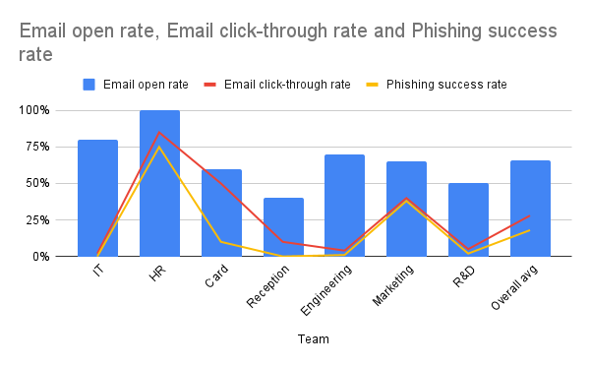
Phishing Campaign Results
Summary of the campaign results. Highlight the most vulnerable teams (HR and Marketing). Brief explanation of the metrics (open rate, click-through rate, success rate).

Slide 4
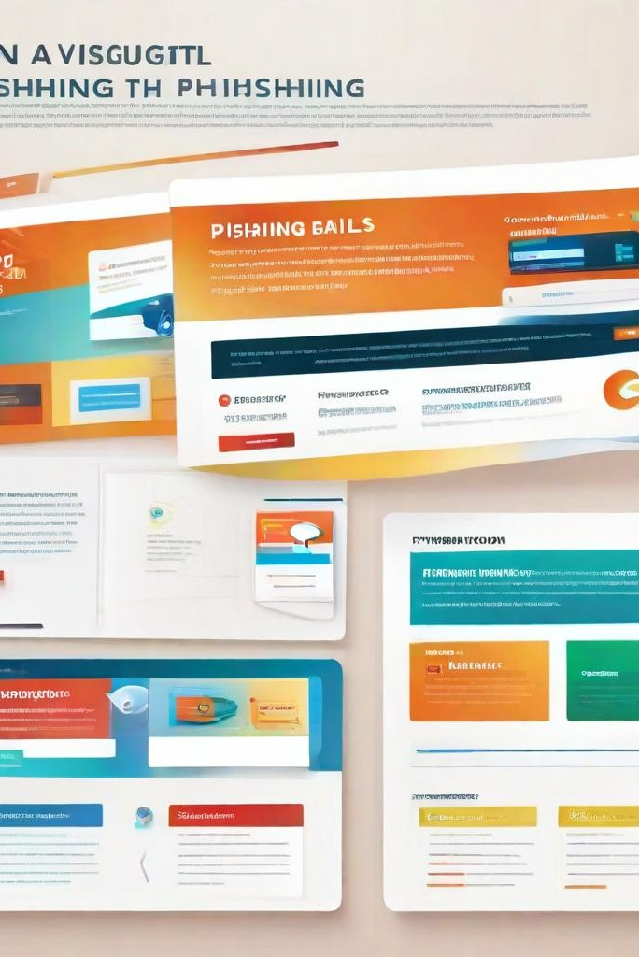
Common Phishing Tactics
Examples of phishing emails (e.g., urgent requests, fake invoices, account verification). Visual examples of phishing emails.
Tips on how to identify phishing emails (e.g., checking the sender’s email address, looking for spelling errors, avoiding clicking on suspicious links).

Slide 5

Protecting Yourself from Phishing
Best practices for avoiding phishing scams (e.g., don’t click on unknown links, verify the sender, report suspicious emails). Importance of using strong, unique passwords. Encouragement to complete additional training and stay vigilant.

Slide 6
How to Protect Yourself
Best practices for avoiding phishing scams (e.g., don’t click on unknown links, verify the sender, report suspicious emails). Importance of using strong, unique passwords. Encouragement to complete additional training and stay vigilant.

Slide 7

Conclusion and Next Steps
Recap of the importance of phishing awareness.
Encourage employees to report phishing attempts and participate in ongoing training.

